Slide 1
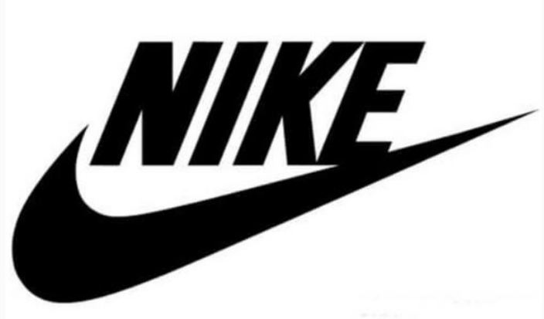
-Swoosh
Just Do It(Analytics):
Dharshini Bala Soundararaj
Jahnavi Billa
Janrey Rivera
Japsehaj Singh Wahi
Jessica Mettu
Sanika Shreekar Gowaikar
Suveethra Tamilselvan
WEB ANALYTICS || PROJECT

Slide 2
INTRODUCTION

Slide 3
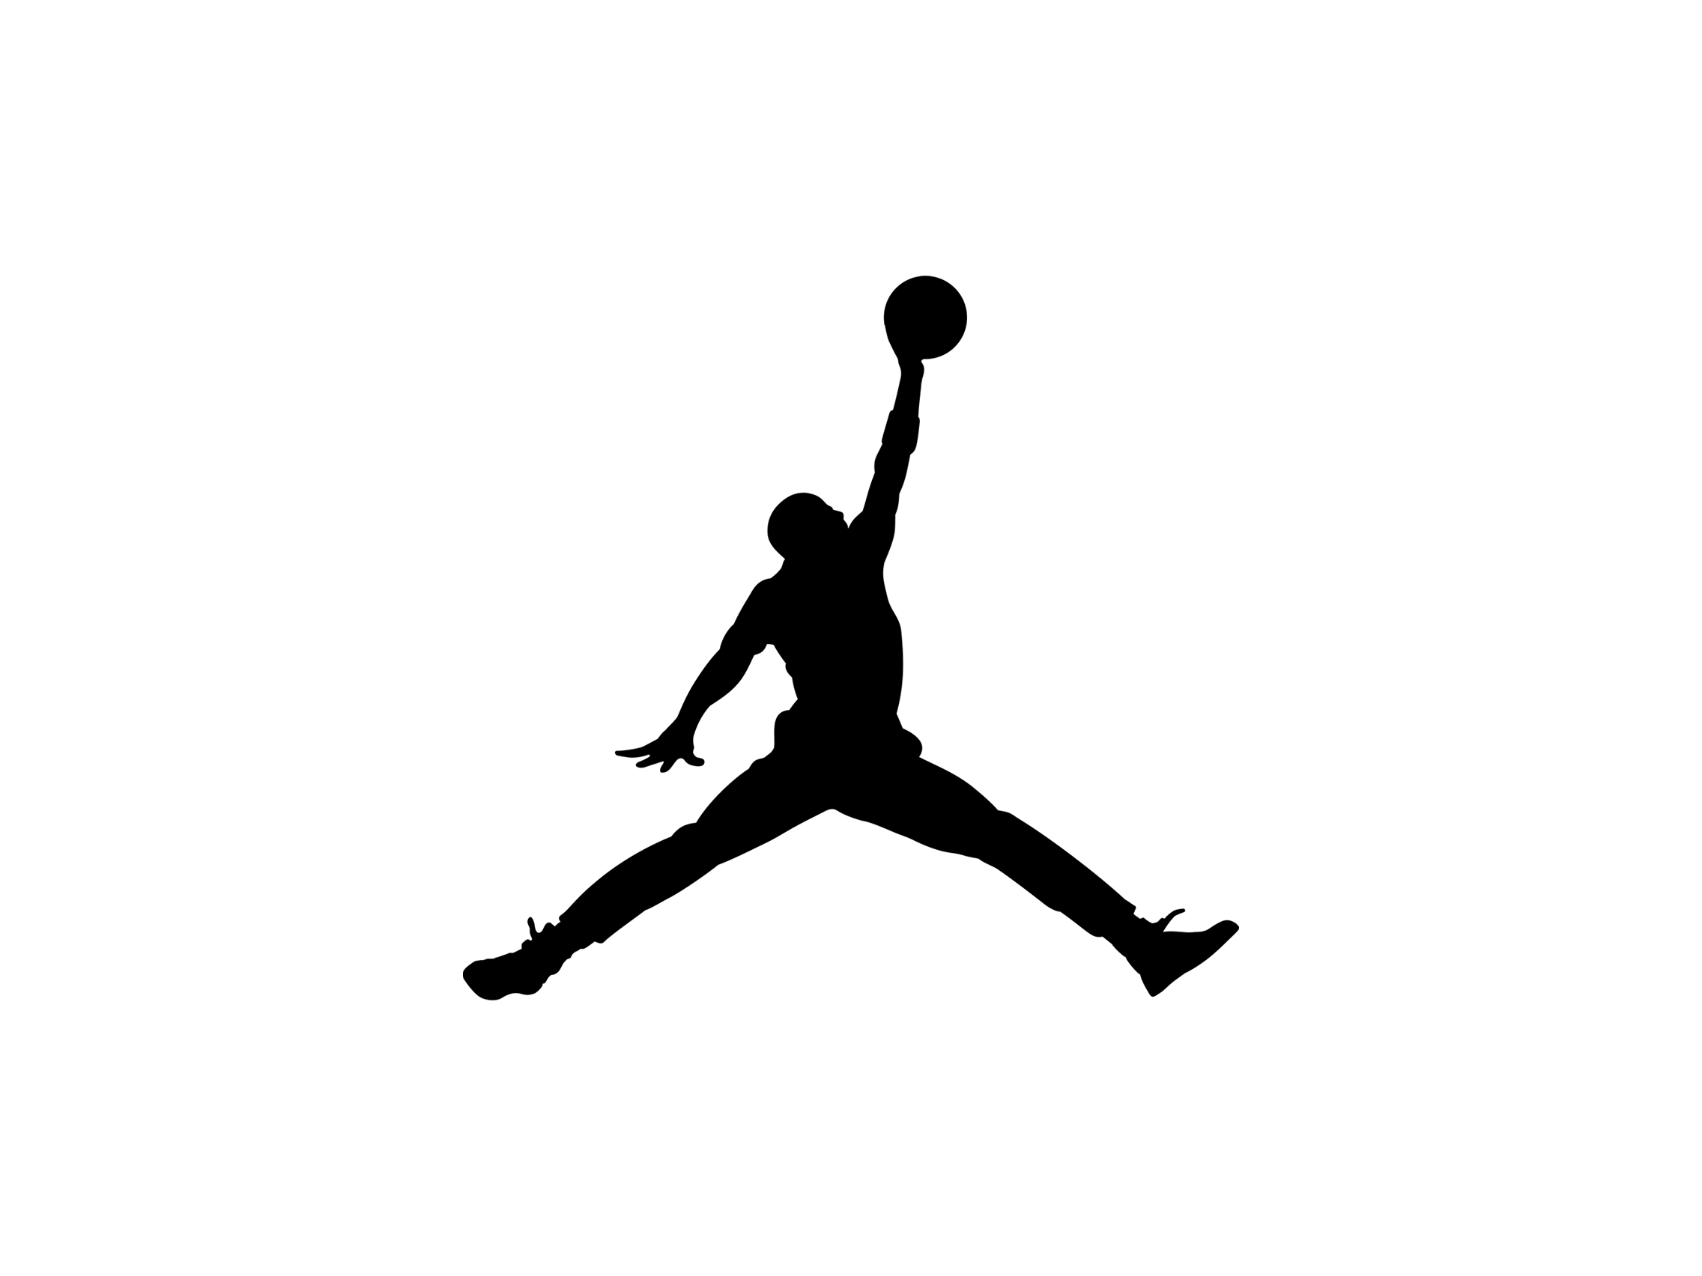
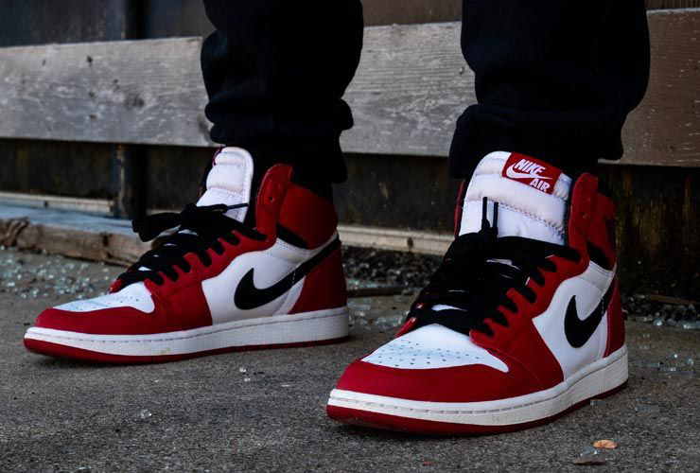
Question – 1 & 2
Who is the company? – Nike, it’s a popular American MNC (Multinational Company) sporting apparel brand; they design, develop, manufacture and sell their sports related products and services.
What products and services do they offer online on their website to customers? Provide a brief overview?
They sell products for men, women and kids and offer services. Please see below the categories of products and services offered. The products are also categorized as collections in the website.
Products
Shoes – 16 categories
Clothing – 15 categories
Sports Accessories and Equipment – 3 categories
Services:
Shoe customization
Product advice
Styling advice
Gift cards
Memberships
Returns
Finding a physical store
Feedback gathering
Shipping and returns
Nike Journal

Slide 4
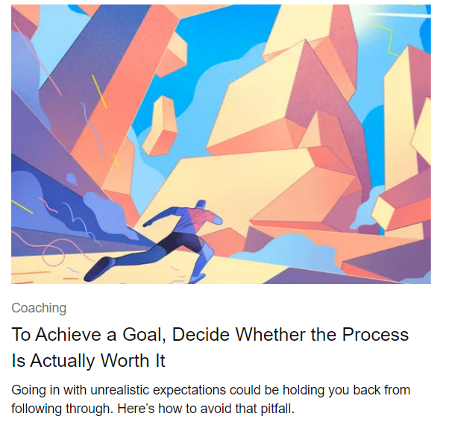
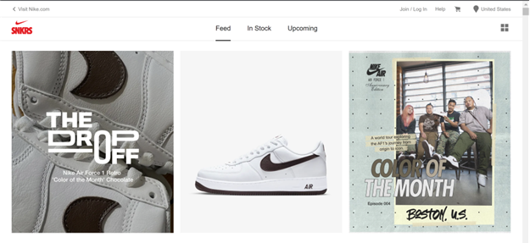
Question – 3
What are 3 key features of the website and design the group collectively feels is working well for the website?
Nike journal – various sports related articles are published
Shoe customization – customers can design their shoes in-terms of styling and shoe size
Good visuals and representation of the products:
360 degree views
Styling advice
Ability to provide reviews with pictures

Slide 5
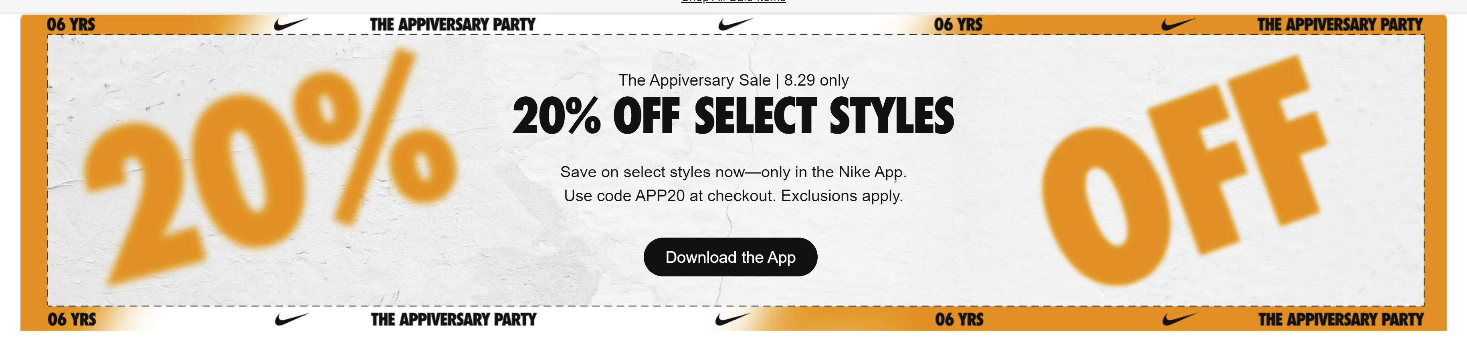
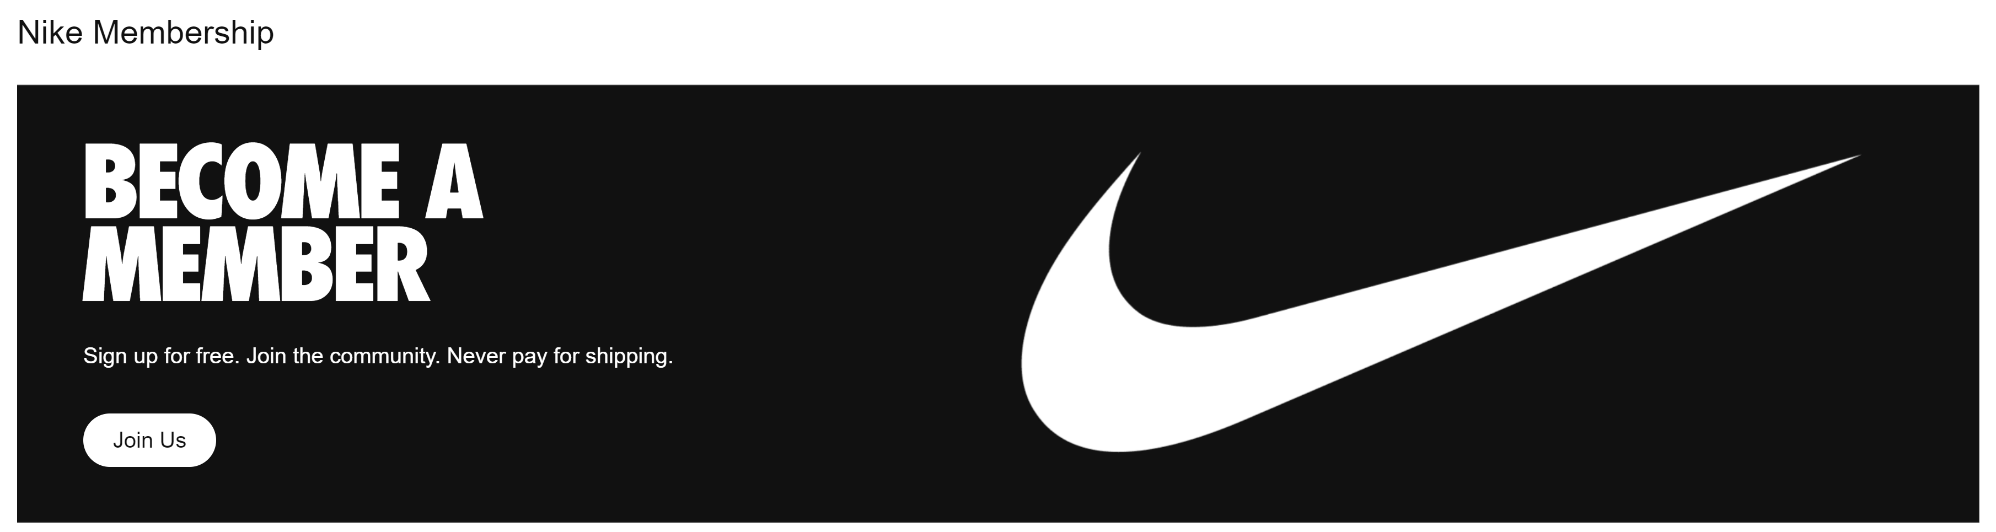
One feature that really caught our eye
Banners that persuade the customers to download the app and membership options to keep the customers engaged in the long run.

Slide 6
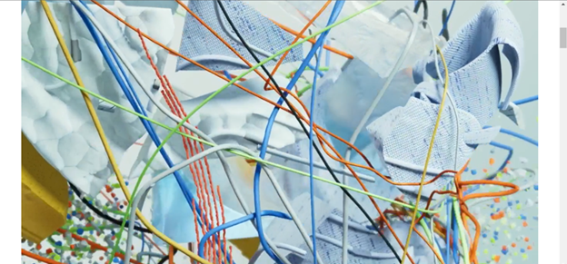
Question – 4
What are 3 key features of the website and design the group collectively feels is an area that is inconvenient, confusing, or could use and update in the online experience?
The animation in the home page doesn’t fit the laptop web browser.
Details on how to measure shoe sizes are not present.
UI can be more aesthetically pleasing by introducing more of their signature black into the design.

Slide 7
Question – 5
On a scale of 1-5, provide how familiar collectively the group is already of this website from a consumer perspective? 1 Being not familiar at all to 5 being very familiar (most members are have shopped on this website before and often)
3; Many of us have visited the website and 1 member is a loyal customer ! 3 of our members have ordered Nike shoes but through other ecommerce websites and other clearance stores.

Slide 8
DIGITAL TRANSFORMATION

Slide 9
Digital Transformation
Factors for embarking on digital transformation
Continuous reconstructing of website : The home page visualizations are too big and company should focus on decreasing number of clicks for completing a transaction.
Customer satisfaction and Customer retention: Personalized recommendations for the members based on their search history.
Efficiency of Website and mobile app: Latency during campaigns – mobile app.
Reasons for making the above recommendation
This will help them to increase their online traffic and improve their conversion rate.
It will also help them to increase their sales by providing a suitable recommendation.

Slide 10
Digital Transformation
6Ps of Digital Transformation w.r.to Nike
Purpose:
Nike is a leading sportswear brand since the 80s, an evidence of how their purpose has been clearly defined and executed. Echoing their vision that everybody is an athlete with their statement "if you have a body, you are an athlete". That goal translates to an all-embracing idea of what defines an athlete - It's not only professionals but also anyone who is simply obsessed with running outdoors can be an athlete. They have been able to effectively unite the world through sports by creating active communities of athletes throughout the globe through apps like NRC and NTC.
Not only selling a shoes, but pitching a lifestyle is what captivates its high-value consumers.
People:
Nike has strong organizational culture driving innovation, the teams are not siloed, and they are very well connected. One thing we would like to tackle is understanding if Nike is investing in the right people and teams to achieve their goals.

Slide 11
Digital Transformation
6Ps of Digital Transformation w.r.to Nike
Platform: We will want to uncover what platforms we can leverage to better understand customer behaviors and optimize their experience when interacting with our website.
Search Engine Marketing tools - Are our blogs reaching our audience with effective SEM?
Heatmapping tools – Are there instances of rage clicking?
Social Media - Are we reaching our target audience? How do we reach untapped market?
Process: We would want to uncover how Nike measures the synergies between people and processes effectively. Does everybody know the value that they bring in the table?
Pace: Nike's data are fully integrated, and visualizations are easily generated that are clear and concise for everyone in the company to digest. We would want to tackle the following questions:
How agile is the company when it comes to executing actions when data insights come in? It's important to understand here how successful Nike is able to utilize the synergy created by their purpose, people, platform and process
Payoff: $175 billion valuation, 47 billion revenue annually
-Quantify ROI based on metrics shown by organic and paid SEM. What is a justifiable ROI in three years

Slide 12
Data Values
Exit rate and bounce rate – To see pages where people are exiting the page without converting, this would help Nike to analyze which products are not selling well or if there is any issue with the aesthetics or performance of the page or product display.
Landing page or Lead capture pages – to see which pages of the website are bringing in more customers. This would help Nike to analyze which of its offerings or campaigns are selling well.
Traffic source – to see through which sources are customers coming to Nike.com, to see if more of their customers are which users – Google/Facebook/blog/email campaign.
Customer Demographics – location, gender, age – to see which segment of customers are buying or subscribing more and correlate with the style of the product they are purchasing.
Style – to see which style of shoe or apparel are they purchasing more and which style is having more exit rate. This would help with customer recommendations and in featuring the most popular content at the top, decreasing the number of clicks.

Slide 13
Governance
Data Governance and its need:
Data Governance will help Nike to maintain good quality data. It also provides the customers the power to control their own data which gets collected by Nike.
This builds trust the customer has for Nike and results in a greater number of returning customers.
Policies like GDPR and CCPA are on the rise and Nike must be careful with customer data to avoid hefty fines.
Essential Steps:
To figure out the purpose of collecting customer data. Collect only what is needed and providing discounts, social media challenges etc. would help customers engage more with their permission and trust. The customers would also know what is it being collected for and how it is being used.
To include lawyers along with digital marketing team and digital analytics team to keep the data collection process in check.
To understand where the data is stored, how it flows throughout your system and check if it is secured.
Set up Tag Governance.
Set up regular audits to make sure that the data collection and maintenance process is in compliance.

Slide 14
Governance
Roles in the Data Governance Team:
Data Lead – Responsible for overseeing the implementation of the data governance program. They help with the transformation of the data while ensuring the integrity and usability of the data. Data lead secures the approval and funding for the governance process.
Data Governance Manager – The manager leads the team in the data governance setup and ongoing process. In smaller teams, data lead and data governance manager role is taken up by the same person.
Data custodian – Data custodian manages the movement, security and usage of the data. The team could have multiple custodians to manage data of various domains of the organization.
Data Governance committee – This team is responsible for making and amending policies related to data governance. This team is overseen by data governance manager and lead.
Data steward – They act as a bridge between business and IT team to access the right data. They oversee the data sets and check whether policies and data tagging are properly implemented. They are experts in domain and data governance knowledge.

Slide 15
SEM STRATEGY

Slide 16
PLA – 3 Keywords
Running shoes
Chrome – Nike was displayed in the third product listing ad (the sale was highlighted) and the product displayed was at low price compared to others. Another product of Nike was also displayed through aggregator website – academy.com later in the listing ad.
The official site link is displayed just below the image displays.
Training shorts
Nike was displayed in the 3rd position with 31 reviews, not much difference in positioning compared to the shoes. The product that has more reviews through the aggregator website is listed in the 6th place.
Activewear
Nike came in the first position with it’s men’s training t-shirt.
The same product is listed in the 8th position through another aggregator website. This indicates that Nike is integrating its sale campaign through both its official and aggregator websites together.
All the products that are listed for ads are having discounted price indicating the Nike is more focusing on campaigning for the products on sale.
Search Notes:
Browser used - Chrome as guest.
ads for the products are displayed at different positions for the same keyword search at different instances – meaning other ad listings were winning the bid sometimes. One of the instance was taken for comparing.

Slide 17
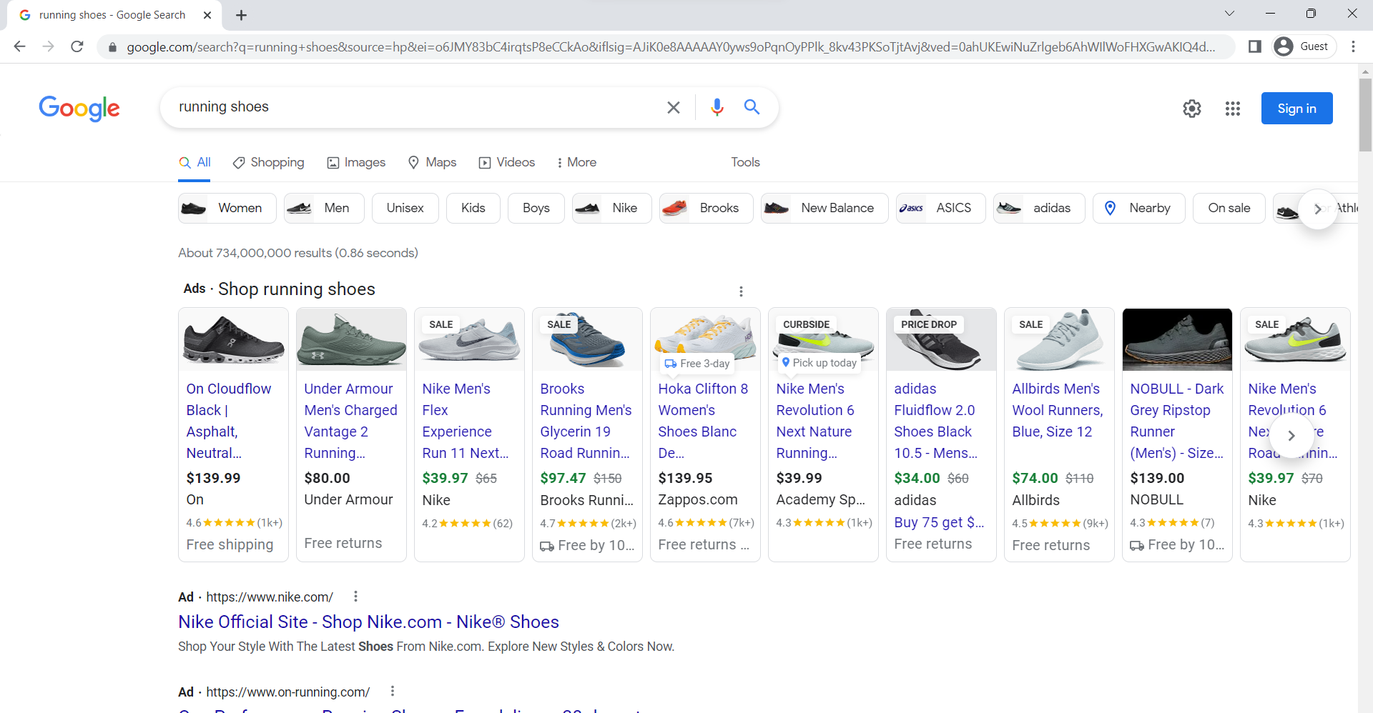
PLA’s – Running shoes

Slide 18
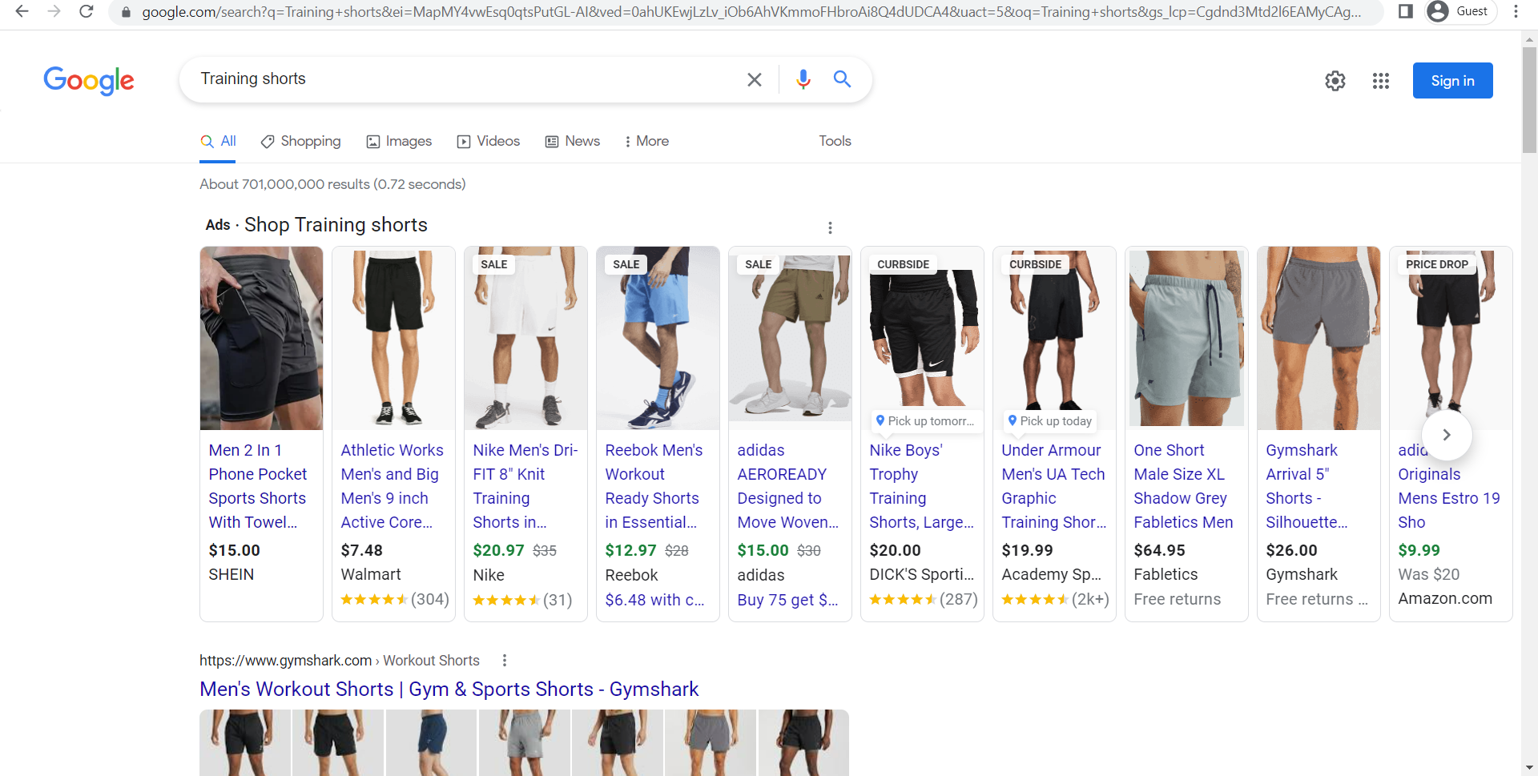
PLA’s – Training shorts

Slide 19
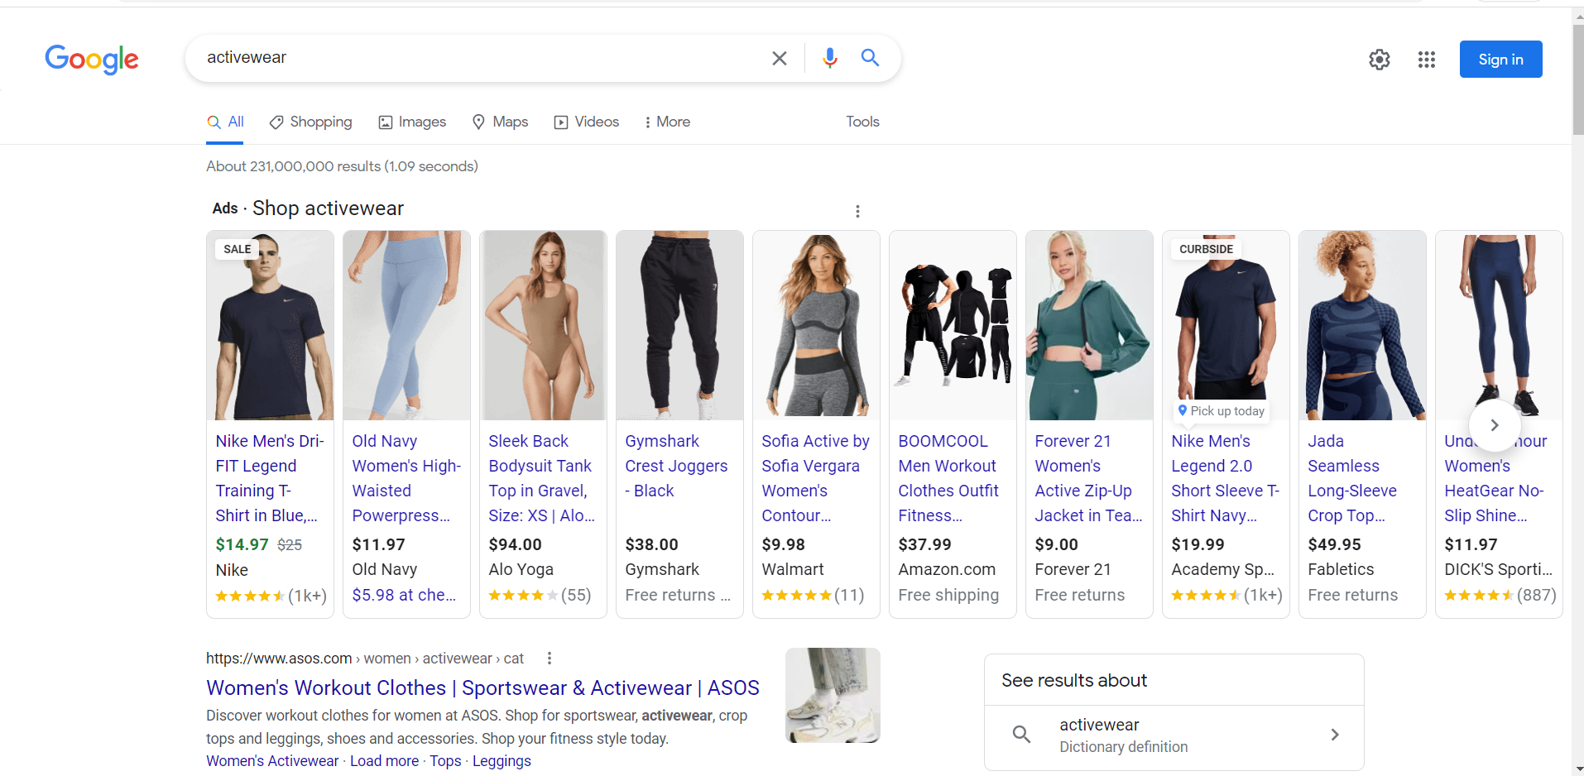
PLA’s – Activewear

Slide 20
PLA’s – Nike Vs Adidas
Running shoes
Adidas only appeared once on this search but shows to be the most aggressive in advertising their sale item for this category. Smaller companies are more aggressive in outbidding major sports brands (e.g., Allbirds, Hoka, Nobull, On). However, overall, Nike dominates this space.
Training shorts
Adidas is a little bit more conservative on advertising training shorts. Noticebly, non-major activewear companies are making an aggressive push to market their products.
Activewear
Adidas is not very aggressive in this space; very fragmented and dominated by non-top athletic brands catered to women (e.g., Old Navy, Forever21, Fabletics) making a push to create awareness on their quality yet cheaper activewear clothing as an alternative to Nike, Under Armour, Gymshark, etc.

Slide 21
3 Key Metrics
Click-through-rate
Easily the most valuable metric that will indicate how relevant and compelling the ad is to target audience
Conversion Rate
Considering buying the product as a successful conversion, we would be able to measure how persuasive the landing pages are after potential buyers click the link.
CPC
Working hand in hand with CTR and Conversion Rate, Nike would want to ensure that they are bidding the right price, displaying relevant products and not excessively burning cash.

Slide 22
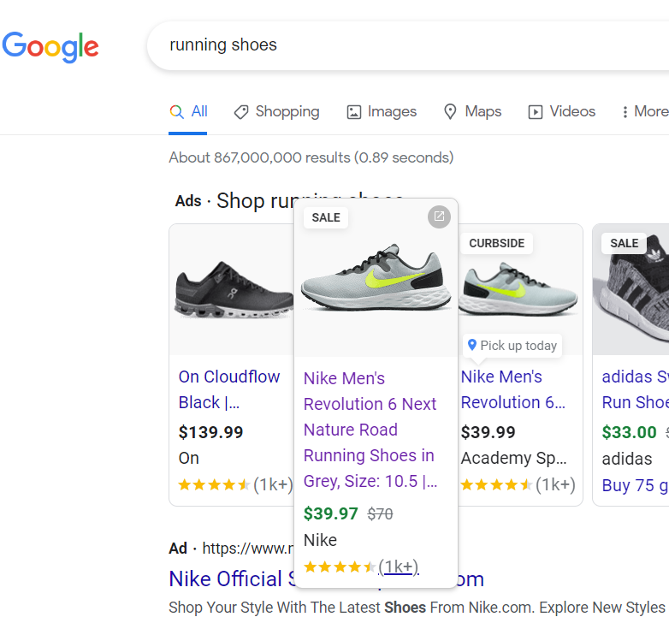
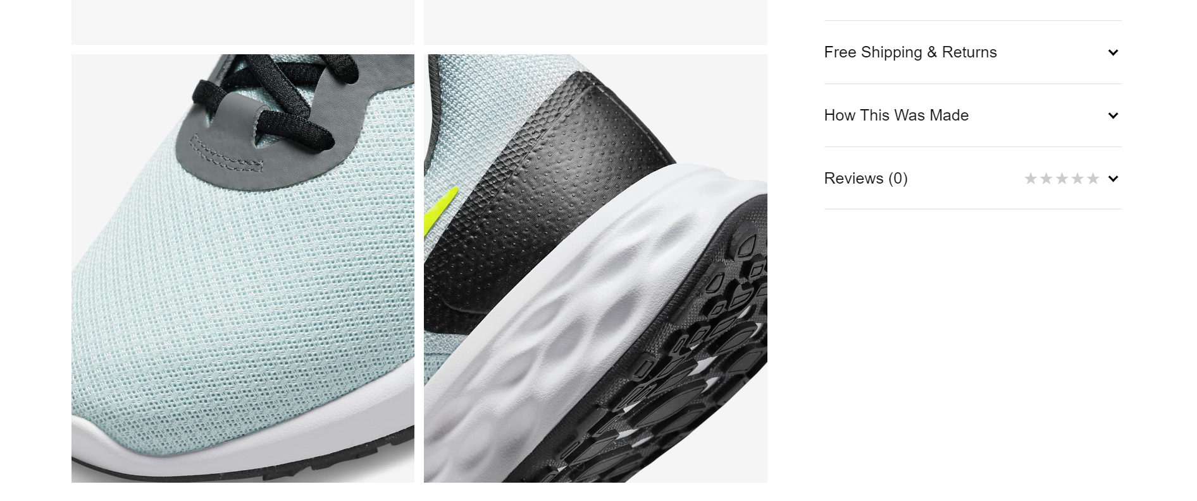
3 Recommendations
Landing page experience:
During the google search, Nike was showing 1k+ reviews but once we land onto the page, we are not able to see any reviews for the same shoe Good user reviews gives a customer confidence about the product and would trigger the customer to click on the product. Sometimes, it could be misleading for customers who would like to see the reviews on the shoes and might start having higher bounce rate impacting the quality score. Targeting ads on products that have reviews could help.
Also, suggesting limited similar models on the landing page can attract customers into upselling.

Slide 23
3 Recommendations
Other factors:
Targeting the right audience:
The young population in developing countries is the target market for the planned improvement marketing plan. Since Nike has mostly been successful in selling its brand image in practically all established markets, it is crucial for the corporation to concentrate on the young population in emerging economies. Young people will make up most of the population in the emerging global economy. For the Nike International Company to continue to grow and expand internationally, utilizing this potential is extremely beneficial. Since the ideal target audience for the proposed digital marketing strategy is the young population, selecting the right demographics for that group is crucial to the plan's success.
Pricing:
Nike has a premium pricing strategy when we search for Nike brand shoes or apparel. People are still prepared to pay for it. This is a result of the brand's high-quality products. Based on customer groupings, needs, and histories, prices must be regulated. For instance, lowering the cost of children's sports programming relative to that of women's and men's sports and displaying the same in the paid ads can spur demand.
Content Creation:
The most effective method for connecting with the audience and making a significant impact. To develop interesting content that addresses client requirements, a variety of media can be used, including blogs, social media, video channels, and print collateral. By conducting thorough keyword research and surveys, companies like Nike can make sure to meet the true demands of their customers.
Content Creation:
The most effective method for connecting with the audience and making a significant impact. To develop interesting content that addresses client requirements, a variety of media can be used, including blogs, social media, video channels, and print collateral. By conducting thorough keyword research and surveys, companies like Nike can make sure to meet the true demands of their customers.

Slide 24
References
https://www.nike.com/
adidas Official Website | adidas US (https://www.adidas.com/us)
Google search for the key terms
Crawl Walk Run Advancing Analytics Maturity with Google Marketing Platform by Michael Loban

Slide 25
SOCIAL MEDIA

Slide 26
Social Media Presence & channels they are on
Nike has an excellent presence on social media, with a highly engaged audience.
Instagram followers: 246M (#1 brand followed on Instagram)
Pinterest followers: 880.6k
Facebook page likes: 15M (not active)
TikTok followers: 3M
They post frequently on their social media (1-2 days). Nike posts attention grabbing content. It has captured the attention of its target audience and they have put up creative posts which would make them want to be a part of their community. Their pages are aesthetically pleasing. Hats off to their social media team!
Nike has an impressive number of followers on each platform.
For LinkedIn, Nike has put forth its purpose very concisely and effectively. It shows how it is to work for Nike. They have also put-up content showcasing their recent events.
Effect:
Since the average age of most of the social media sites mentioned is relatively young, Nike is able to target people who would be more inclined to buy fitness apparel. Their social media accounts are marvelous marketing opportunities. Knowing how big sports is in the global arena, their international presence is very strong, especially with the list of high-profile athletes endorsing Nike around the globe.
Nike has done a good job to leverage this advantage. Their online presence has the potential to bring in loyal customers across the world.

Slide 27
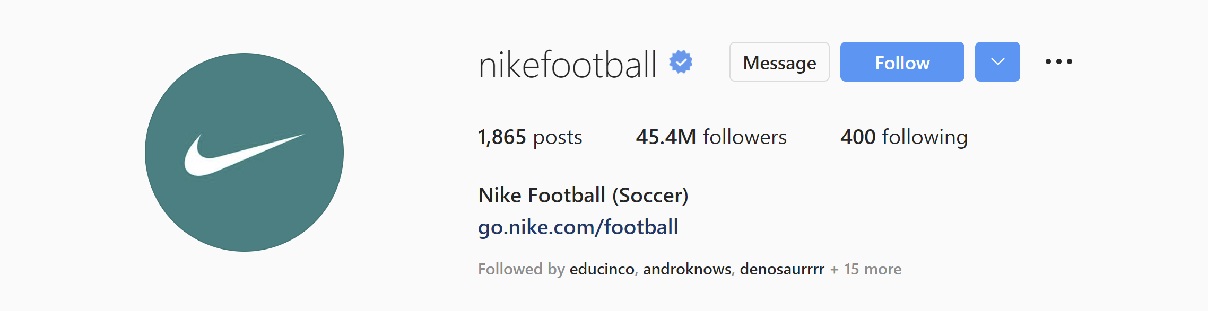
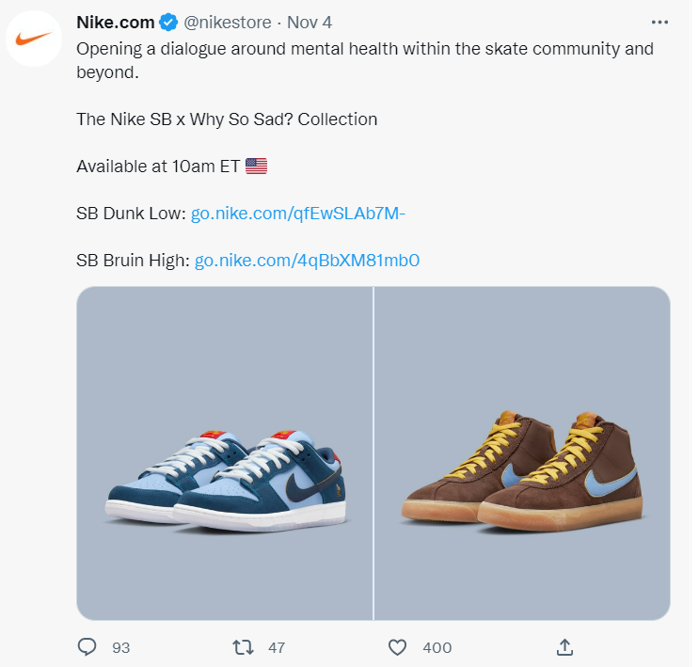
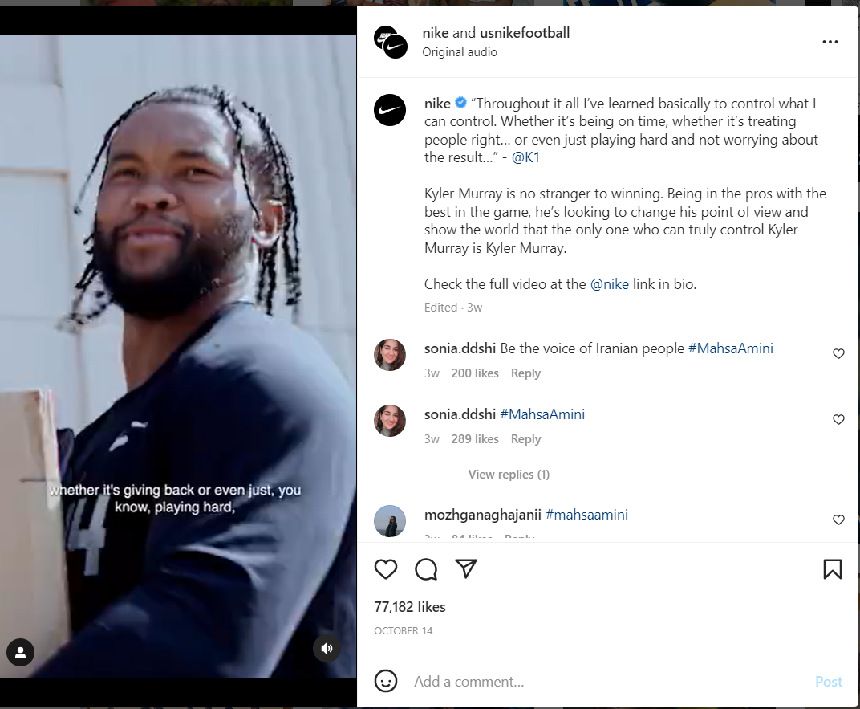
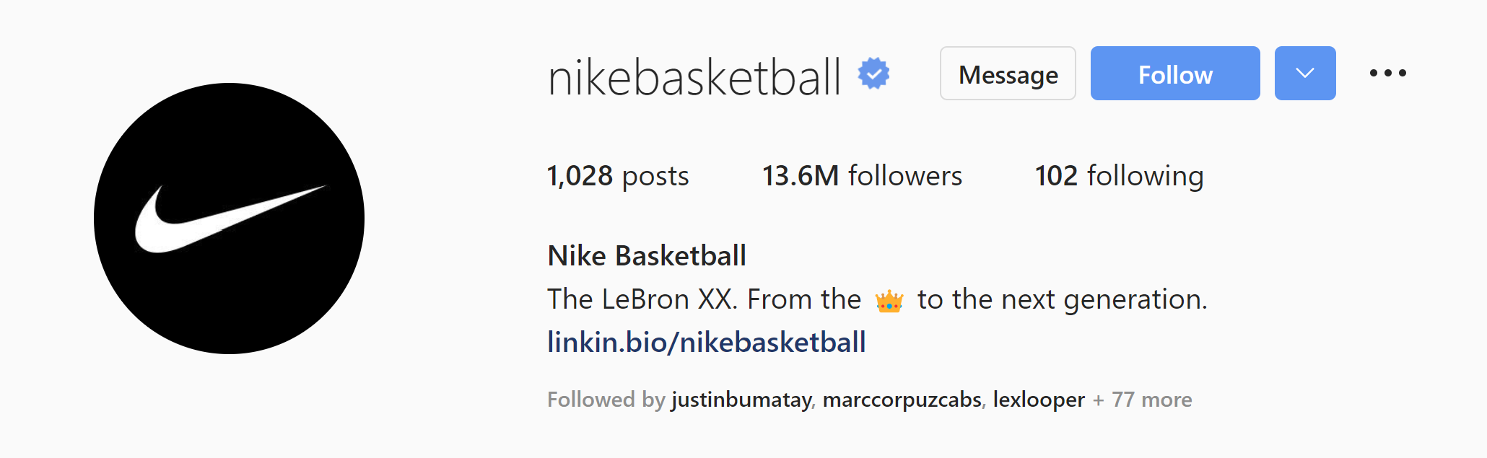
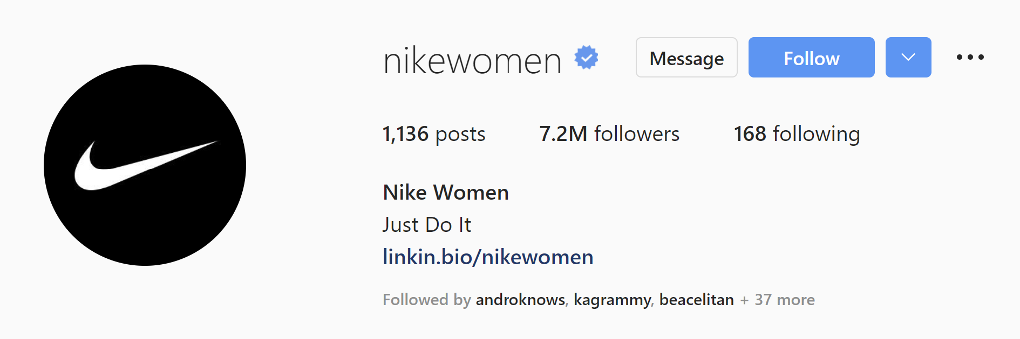
Engaging with Audience
They have several targeted channels/accounts on each platform (Twitter, Instagram, etc) – for the type of sport, cause and Nike as a brand (e.g. @nikefootball, @nikerunning, @nikebasketball, @nikewomen, etc).
They post social content mostly related to athletes or a mix of athletic world and social cause.
They are focused on creating impact on their users' and community’s mind and use social media as a platform for their various communities to discuss recent athletic news or controversial campaigns.
They also promote their upcoming products launches through social media.

Slide 28
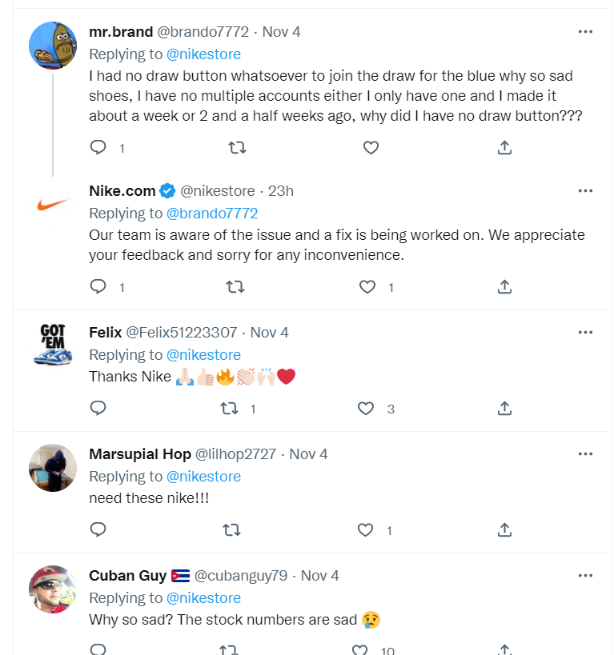
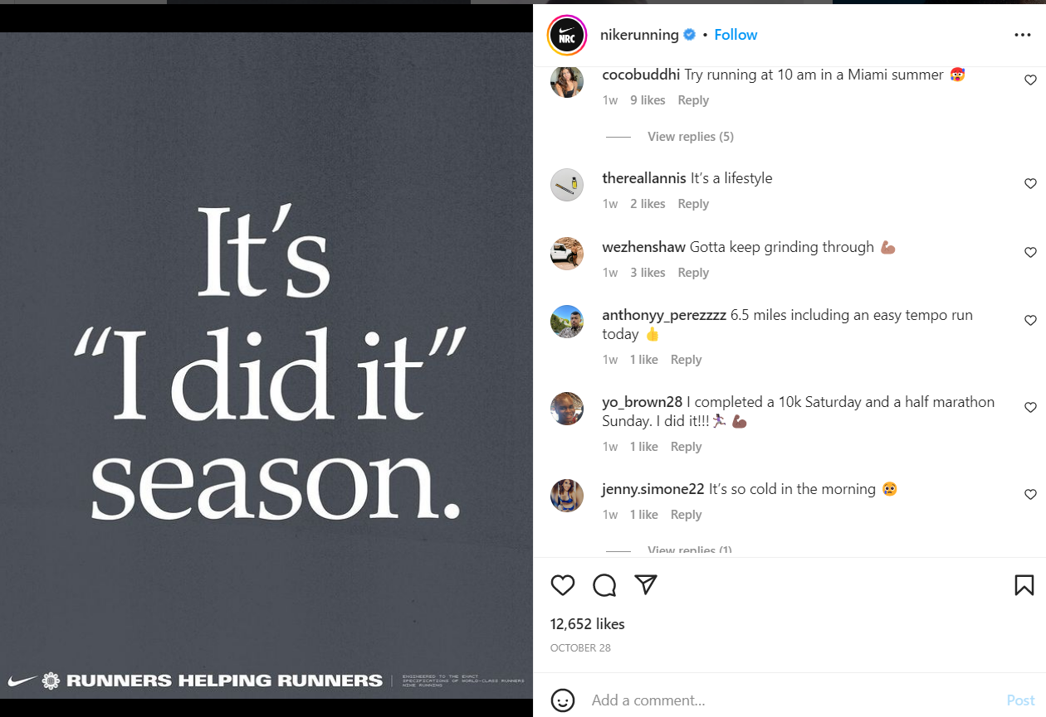
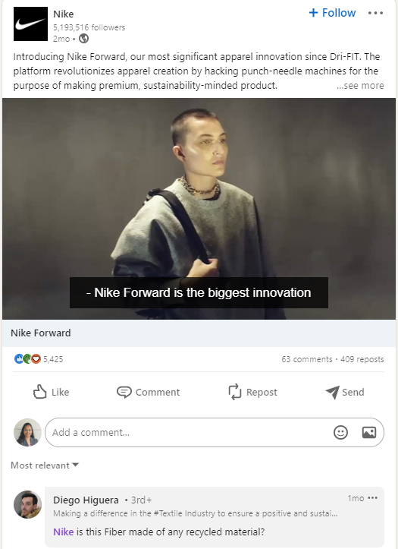
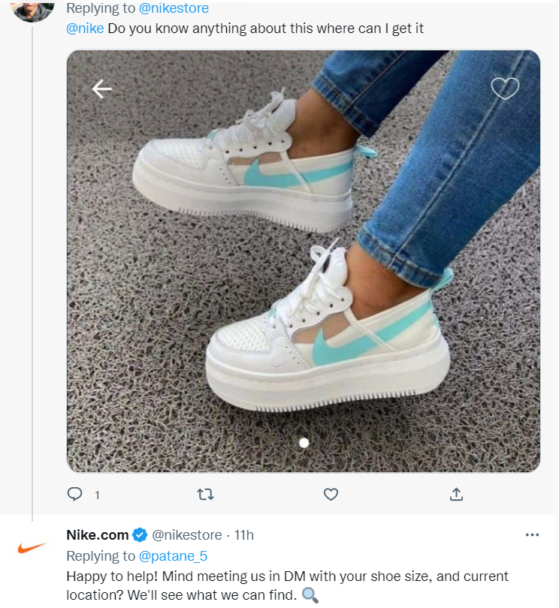
Engagement from Customers
Response from the users (User sentiment) is mostly positive.
Any feedback from the users is worked upon by Nike team and responded.
Customers have the flexibility to reach out to Nike on social media with their question on where they can find the products as well.
For focused channels on a sport, customers interact relevantly discussing recent sports event.

Slide 29
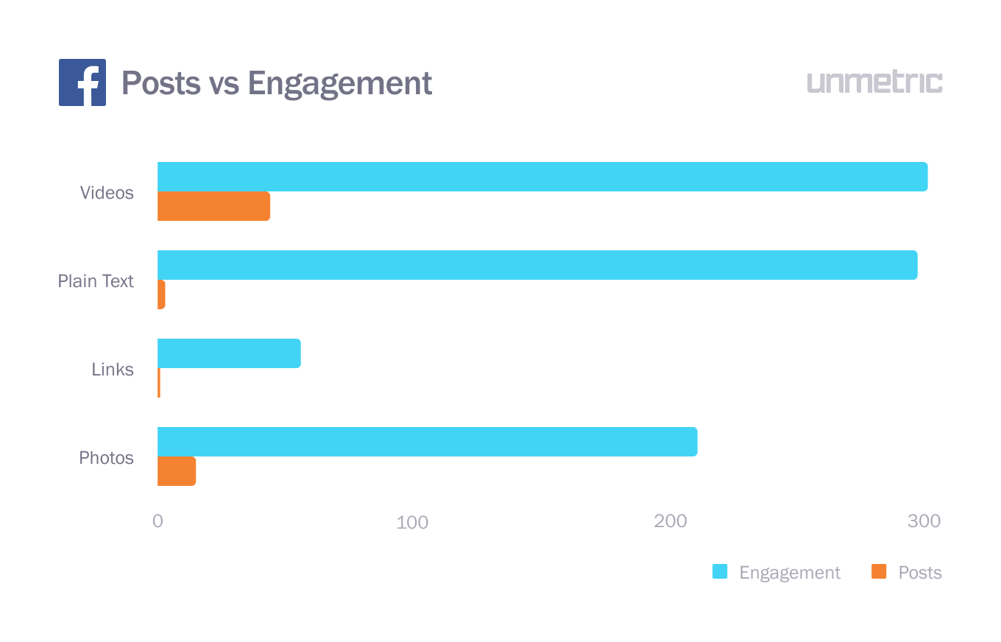
Engagement from Customers (contd.)
They have very good customer engagement compared to the number of posts they do speaks about how impactful each post is.
Nike's high-profile customers' posts and comments on social media show the reliability the brand can provide.
NIKE posts Vs Engagement on Facebook
Source: https://blog.unmetric.com/nike-social-media#:~:text=The%20sportswear%20giant%20is%20a%20champion%20on%20social,the%20most%20followed%20brand%20with%2092%20million%20followers%21

Slide 30
Social Media as Customer Service Channel
Nike is a brand that doesn't need to connect with its customers through online chatter. Years of marketing have already resulted in that relationship. Nike's social media engagement is defined by what its cult-like fan base experiences and shares during their activities. So, unless someone needs assistance, Nike only speaks to groups and does not converse with individuals.
They understand that they are not selling shoes, but rather an attitude and a way of life. Needless to say, they're equally adept at delivering assistance. Nike is one of the most active Twitter customer service accounts.
They have a specialized Twitter account, Team Nike, that offers assistance seven days a week in seven languages (English, Spanish, French, Dutch, Italian, German & Japanese). Despite being bombarded with assistance inquiries all day, they never lose patience. What we can really appreciate is @Teamnike's customer service is the time it takes to rectify difficulties.
246 million Instagram followers and 8.3 million Twitter followers (two most-followed active channels). If you go to these two pages, you will see exactly matched voices and activities that Nike says and does. Nike's social media marketing strategy includes the following tactics:
Collaborating with well-known individuals.
Making use of user-generated material.
Showing up in customer conversations
Distributing your article via social media channels.

Slide 31
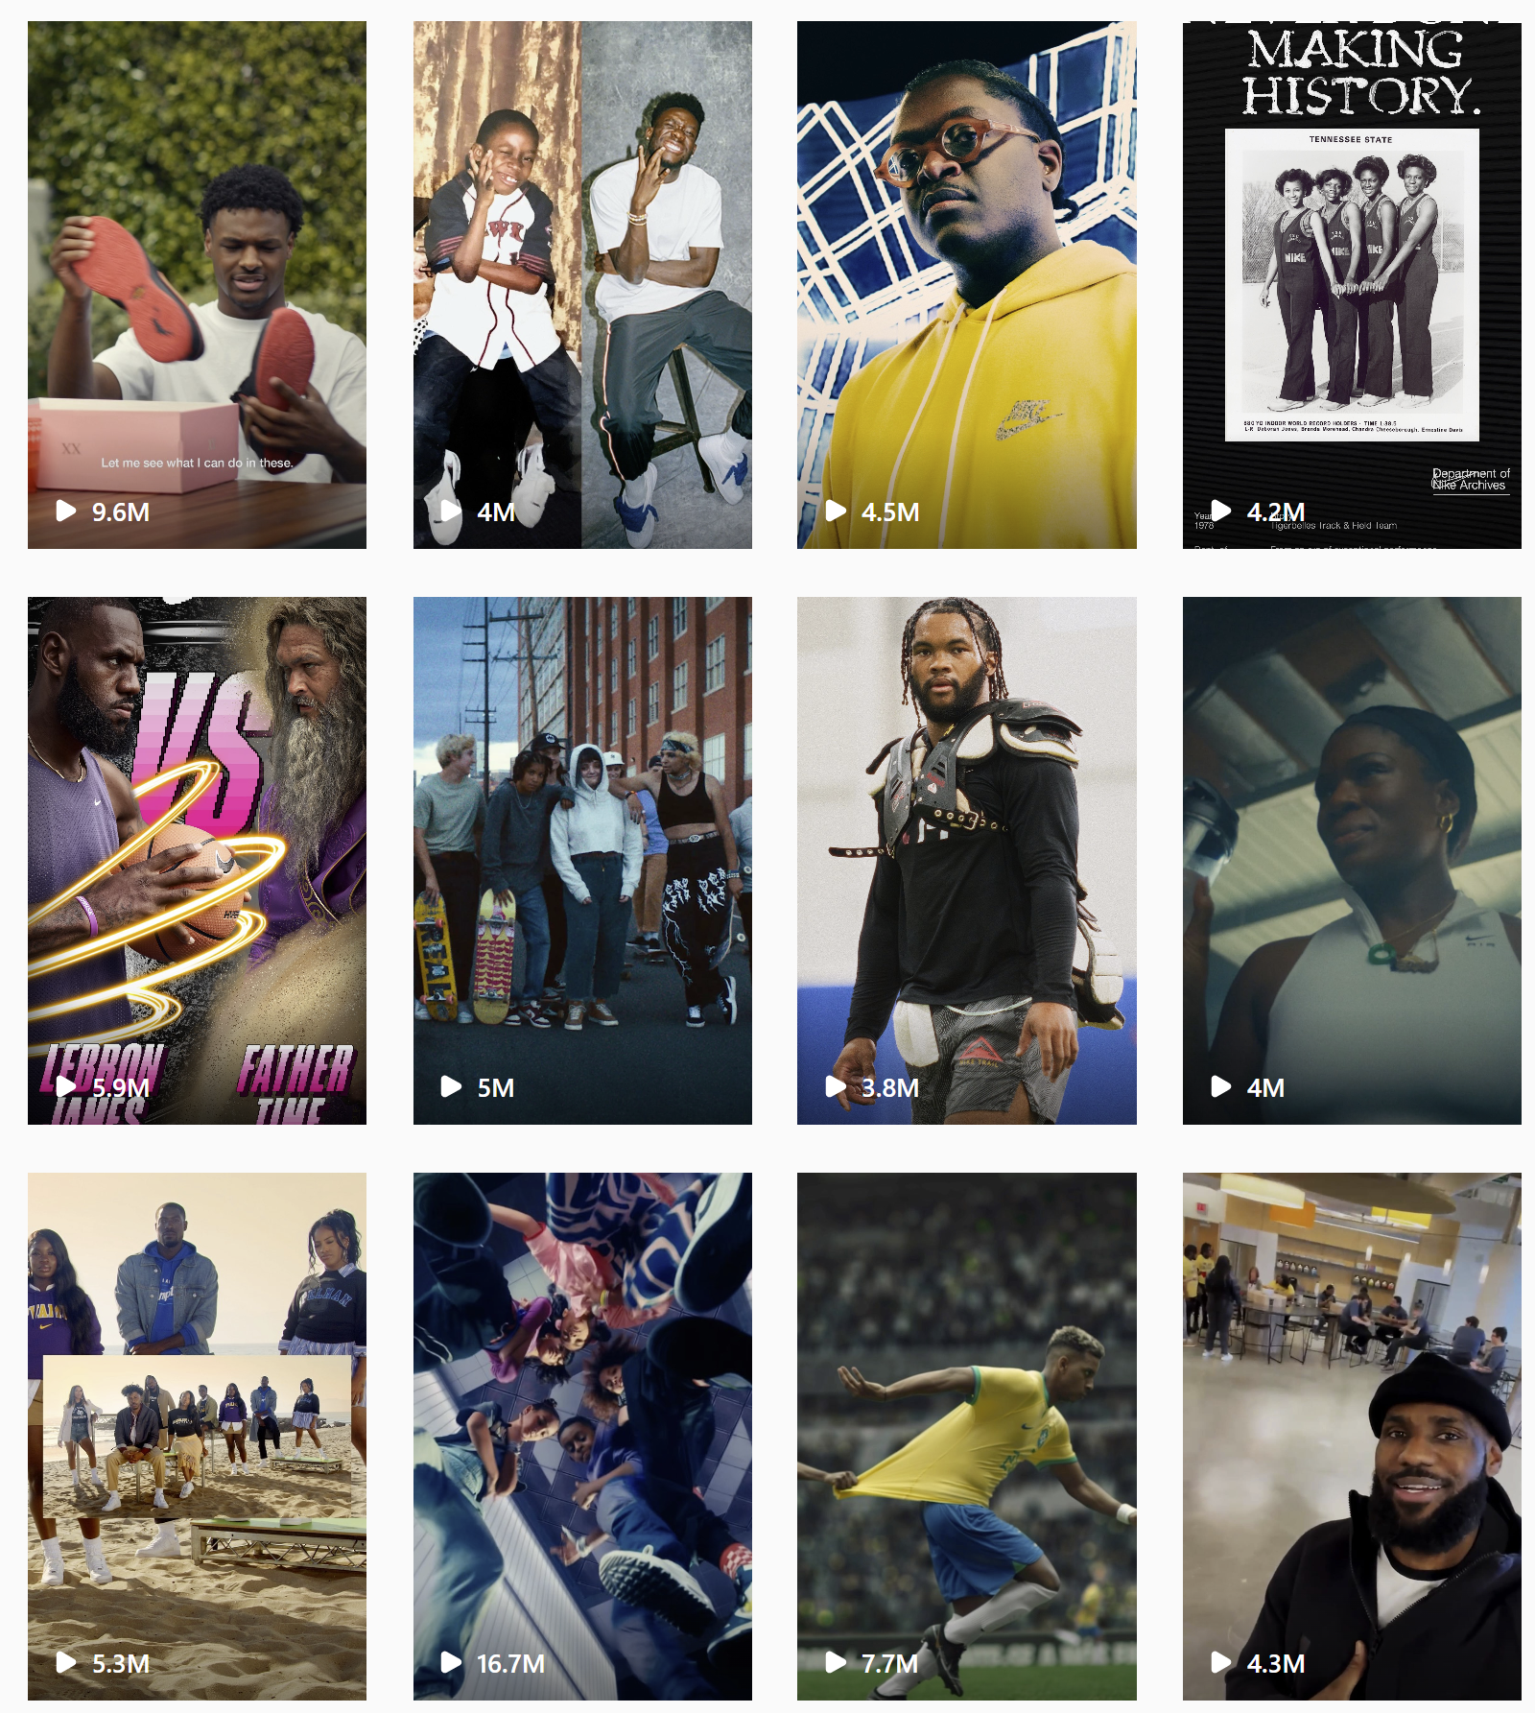
Social Media Strategies
Nike uses storytelling as their main strategy to make compelling connections with its audience. The centerpiece of their stories are seldom the products but the athletes and the physical, socio-economic, and mental challenges they faced to get to where they are today, inspiring the younger generations of athletes. They also tackle relevant topics in today's world (Black Lives Matter, Stop Asian Hate, LGBT, Refugees, etc) to show the human-side of sports. The best way to tell stories is to create video contents.

Slide 32
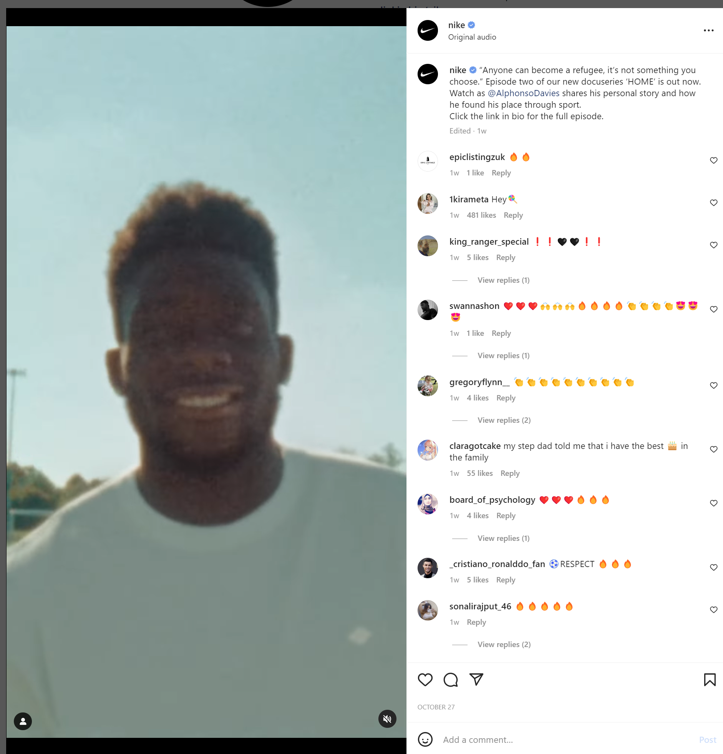
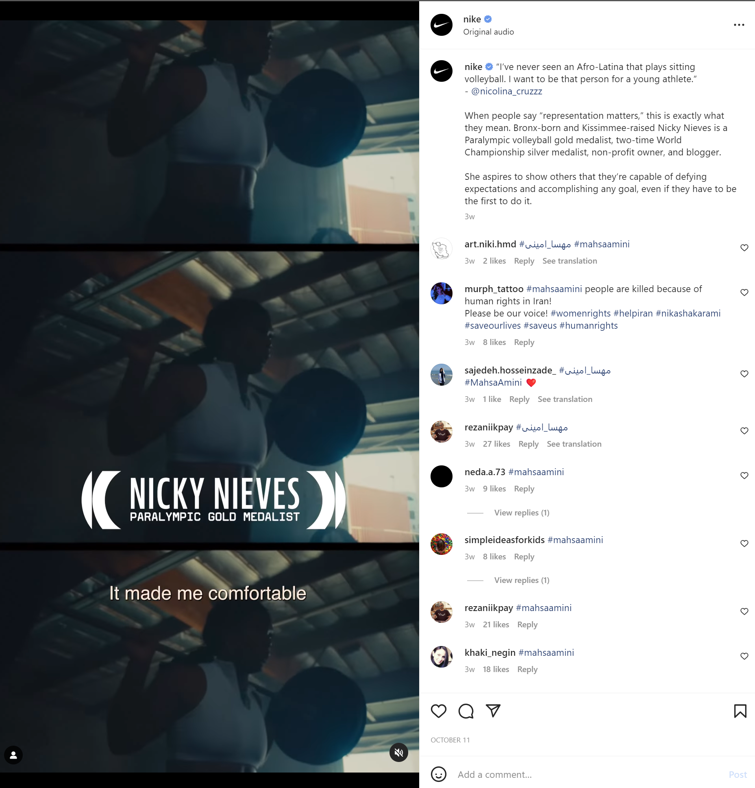
3 Metrics
Our team noticed that on their Instagram page, videos relating to personal stories of Nike athletes (excluding big names like LeBron James, Cristiano Ronaldo, Rafael Nadal), Nike endorsers creating a dialogue about inclusion and representation, and whatnot are not performing as well compared to regular posts showcasing upcoming products and their high-profile athletes. Therefore, below are 3 metrics that are important to Nike to measure their social media strategies.
Views: (Average ~10+m views for regular posts relating to products, top athletes; ~4m views for more compelling stories)
Mentions: Their huge network of high-profile athletes and celebrities increases their presence in the online world globally. These people are very influential from a marketing perspective.
Likes: (Average ~200+k likes for regular posts relating to products, top athletes; ~80k views for more compelling stories)

Slide 33
3 recommendations
Most revolves around athletes and high performing shoes. Nike should also focus on Community oriented programs and socialize those.
Nike can also focus on their mid-range products so that they have even broader range of customers that can feel included.
Most of their social media presence is on shoes, they can also improve on apparel side of their business.
Personal Note from the group: Nike is the most followed brand on Instagram and is the market leader on social media presence. How do we even recommend anything? Lol Jk.

Slide 34
References
Twitter, Linkedin, Instagram, Tiktok and facebook searches of Nike
Crawl Walk Run Advancing Analytics Maturity with Google Marketing Platform by Michael Loban
https://blog.unmetric.com/nike-social-media#:~:text=The%20sportswear%20giant%20is%20a%20champion%20on%20social,the%20most%20followed%20brand%20with%2092%20million%20followers%21

Slide 35
SEGMENTATION

Slide 36
Segments
We would like to target 2 customer segments.
Semi-urban users between 15 – 30.
High Net worth individuals interested in sports and athleisure.
We would be using demographic, behavioral and psychographic attributes for customer segmentation to target the right set of market segment for the marketing efforts.
Demographic helps us in identifying the young adults by age and also by income.
Geographic will help in identifying the type of city.
Psychographic data will help us identify customers interested in sports, we can identify the segment using Google Analytics affinity category.
3 Key benefits:
Building deep relationships with existing customers as well as expanding the market and reaching a broader world.
Getting young adults into the Nike community, getting them to form a longer loyal bond with the company.
Continuing with the brand image and also continuing the bond the company has with their high end athletic customers by focusing on the high net worth athlete's loyalty to the brand.

Slide 37
A/B TESTING

Slide 38
A/B Testing
Semi-urban
Athleisure – affluent, health conscious, and stylish
The focus of the landing page is to showcase Nike’s sleek, comfort and cozy yoga wear with the goal of strengthening Nike’s capabilities to capture Lululemon’s market in this space.

Slide 39
INSIGHTS

Slide 40
SUMMARY

Slide 41
Summary
Features working well for Nike are Nike Journal, Shoe Customization, visual representation of products with 360deg view, and style tips.
The animation on their home page and Website theme needed some improvements as they were making the page inconvenient and less aligned with their brand.
Data values that will be useful for further investigation of the website are Exit rate, Bounce Rate, Landing page, Lead Capture pages, Traffic Source, Customer Demographics, and Style.
Based on Nike's current SEM presence online, we suggest three tips:
Targeting the right audience: Since Nike has mostly been successful in selling its brand image in practically all established markets, the corporation must concentrate on the young population in emerging economies. Young people will make up most of the population in the emerging global economy.
Pricing: Nike has a premium pricing strategy when we search for Nike brand shoes or apparel. Prices can be regulated based on customer groupings, needs, and histories. For instance, lowering the cost of children's sports programming relative to women's and men's sports and displaying the same in paid ads can spur demand.

Slide 42
Landing page experience: During the google search, Nike showed 1k+ reviews, but once we landed on the page, we could not see any reviews for the same shoe. Good user reviews give a customer confidence about the product and would trigger the customer to click on the product. Sometimes, it could be misleading for customers who would like to see the reviews on the shoes and might start having a higher bounce rate impacting the quality score. Targeting ads on products that have reviews could help.
Based on Nike's current Social Media online, we proposed three recommendations:
Most social media posts revolve around athletes and high-performing shoes. Nike should also focus on Community-oriented programs and socialize those.
Nike can also focus on their mid-range products to have an even broader range of customers who can feel included.
Most of their social media presence is on shoes. They can also improve on the apparel side of their business.

